Slide 1



Elastic Map Reduce
Shadi Khalifa
Database Systems Laboratory (DSL)
khalifa@cs.queensu.ca

Slide 2









The Amazon Web Services Universe
Cross Service
Features
Management
Interface
Platform Services
Infrastructure
Services

Slide 3


Infrastructure Services
EC2
http://aws.amazon.com/ec2/
Infrastructure
Services
VPC
http://aws.amazon.com/vpc/
S3
http://aws.amazon.com/s3/
EBS
http://aws.amazon.com/ebs/

Slide 4

Amazon Simple Storage Service (S3)
Infrastructure
Services
Amazon S3 provides a simple web services interface that can be used to store and retrieve any amount of data, at any time, from anywhere on the web.
Write, read, and delete objects containing from 1 byte to 5 terabytes of data each. The number of objects you can store is unlimited.
Each object is stored in a bucket and retrieved via a unique, developer-assigned key.
  A bucket can be stored in one of several Regions.
  You can choose a Region to optimize for latency, minimize costs, or address regulatory requirements.
  Objects stored in a Region never leave the Region unless you transfer them out.
Authentication mechanisms are provided to ensure that data is kept secure from unauthorized access.
  Objects can be made private or public, and rights can be granted to specific users.
S3 charges based on per GB-month AND per I/O requests AND per data modification requests.

Slide 5
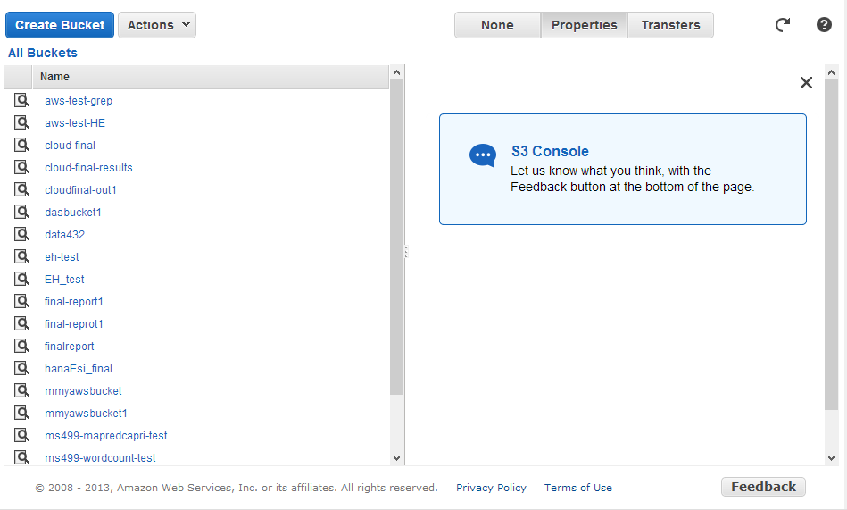

Slide 6






Platform Services
EMR
http://aws.amazon.com/elasticmapreduce/
Platform Services
RDS
http://aws.amazon.com/rds/
DynamoDB
http://aws.amazon.com/dynamodb/
Beanstalk
http://aws.amazon.com/elasticbeanstalk/

Slide 7

Amazon Elastic MapReduce (EMR)
Platform Services
Amazon EMR is a web service that makes it easy to quickly and cost-effectively process vast amounts of data using Hadoop.
Amazon EMR distribute the data and processing across a resizable cluster of Amazon EC2 instances.
With Amazon EMR you can launch a persistent cluster that stays up indefinitely or a temporary cluster that terminates after the analysis is complete.
Amazon EMR supports a variety of Amazon EC2 instance types and Amazon EC2 pricing options (On-Demand, Reserved, and Spot).
When launching an Amazon EMR cluster (also called a "job flow"), you choose how many and what type of Amazon EC2 Instances to provision.
The Amazon EMR price is in addition to the Amazon EC2 price.
Amazon EMR is used in a variety of applications, including log analysis, web indexing, data warehousing, machine learning, financial analysis, scientific simulation, and bioinformatics.

Slide 8
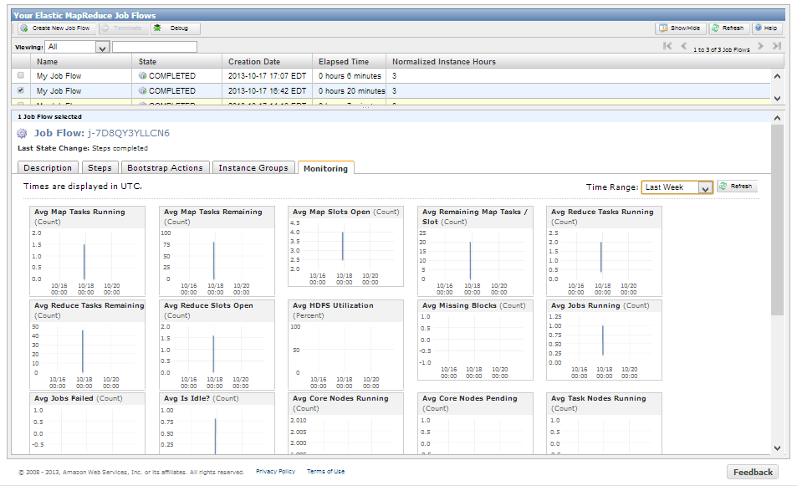

Slide 9

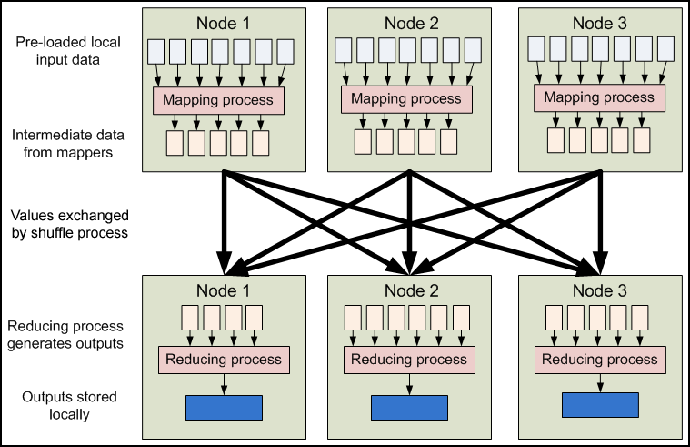
What is Hadoop?
Notes:
Hadoop is the open source implementation of Google’s MapReduce. It works on dividing the data into a number of smaller chunks and process them in parallel.
The map phase takes the input and process them into key-value pairs. These values represent the intermediate data and is stored locally on the map nodes.
Then comes the shuffle phase where same key data is transferred to the same Reduce node.
Finally, the Reduce node process the data of the same key but from different Map nodes and produce the job output that can be used as an input to another MapReduce job.

Slide 10
Example: Word Count
Objective: Count the number of occurrences of each word in the provided input files.
How it works
  In the Map phase the text is tokenized into words then we form a key value pair with these words where the key being the word itself and value is set to ‘1’.
  In the reduce phase the keys are grouped together and the values for the same key are added.

Slide 11
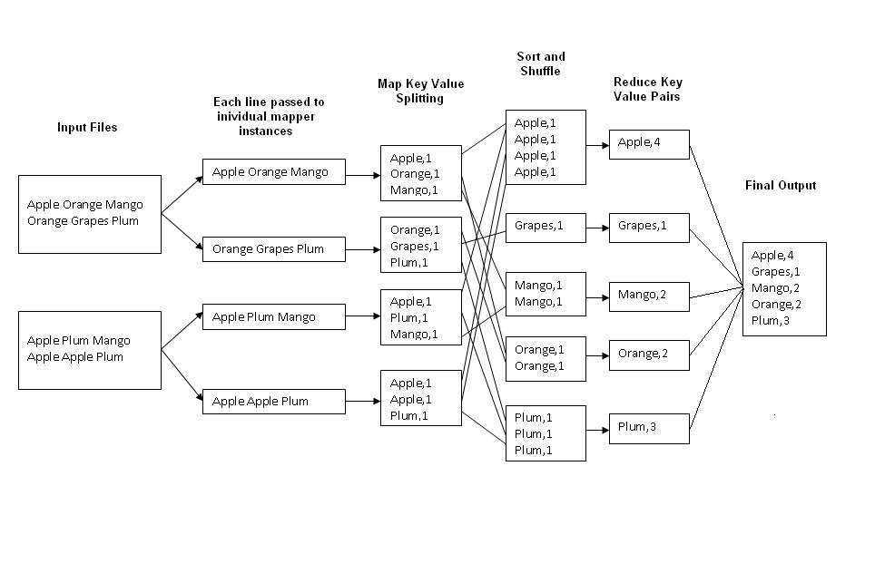

Slide 12

Example 2: Joins with MapReduce
UserDetails.txt
123 456, Jim
456 123, Tom
789 123, Harry
789 456, Richa
A retailer has a customer data base and he needs to do some promotions.
He chooses bulk sms as the choice of his promotion which is done by a third party.
Once the SMS is sent, the SMS provider returns the delivery status back to the retailer.
We have 2 input files as follows:
  UserDetails.txt : Every record is of the format ‘mobile number , consumer name’.
  DeliveryDetails.txt: Every record is of the format ‘mobile number, delivery status’.
Objective: Associate the customer name with the delivery status.
DeliveryDetails.txt
123 456, Delivered
456 123, Pending
789 123, Failed
789 456, Resend
Expected Output
Jim, Delivered
Tom, Pending
Harry, Failed
Richa, Resend
http://kickstarthadoop.blogspot.ca/2011/09/joins-with-plain-map-reduce.html

Slide 13
Formulating as a MapReduce
Since we have 2 input files, we need 2 Map functions (one for each input file)
  UserDetails.txt
    Key: mobile number
    Value: ‘CD’ for the customer details file + Customer Name
  DeliveryDetails.txt
    Key: mobile number
    Value: ‘DR’ for the delivery report file + Status
On the reducer, every key would be having two values (for simplicity) one with prefix ‘CD’ and other ‘DR’.
From CD get the customer name corresponding to the cell number (input key) and from DR get the status.
The output Key values from the reducer would be as follows
  Key : Customer Name
  Value : Status Message
UserDetails.txt
<123 456, CD~Jim>
<456 123, CD~Tom>
<789 123, CD~Harry>
<789 456, CD~Richa>
Reduce Input
<123 456, CD~Jim>
<123 456, DR~Delivered>
<456 123, CD~Tom>
<456 123, DR~Pending>
DeliveryDetails.txt
<123 456, DR~Delivered>
<456 123, DR~Pending>
<789 123, DR~Failed>
<789 456, DR~Resend>
Reduce Output
<Jim, Delivered>
<Tom, Pending>

Slide 14



Tools you will need
Eclipse IDE for Java EE Developers
  http://www.eclipse.org/downloads/packages/eclipse-ide-java-ee-developers/keplersr1
hadoop-core-1.2.1.jar
  http://mvnrepository.com/artifact/org.apache.hadoop/hadoop-core/1.2.1
Amazon Web Services Account
  https://console.aws.amazon.com/elasticmapreduce/home?region=us-east-1

Slide 15
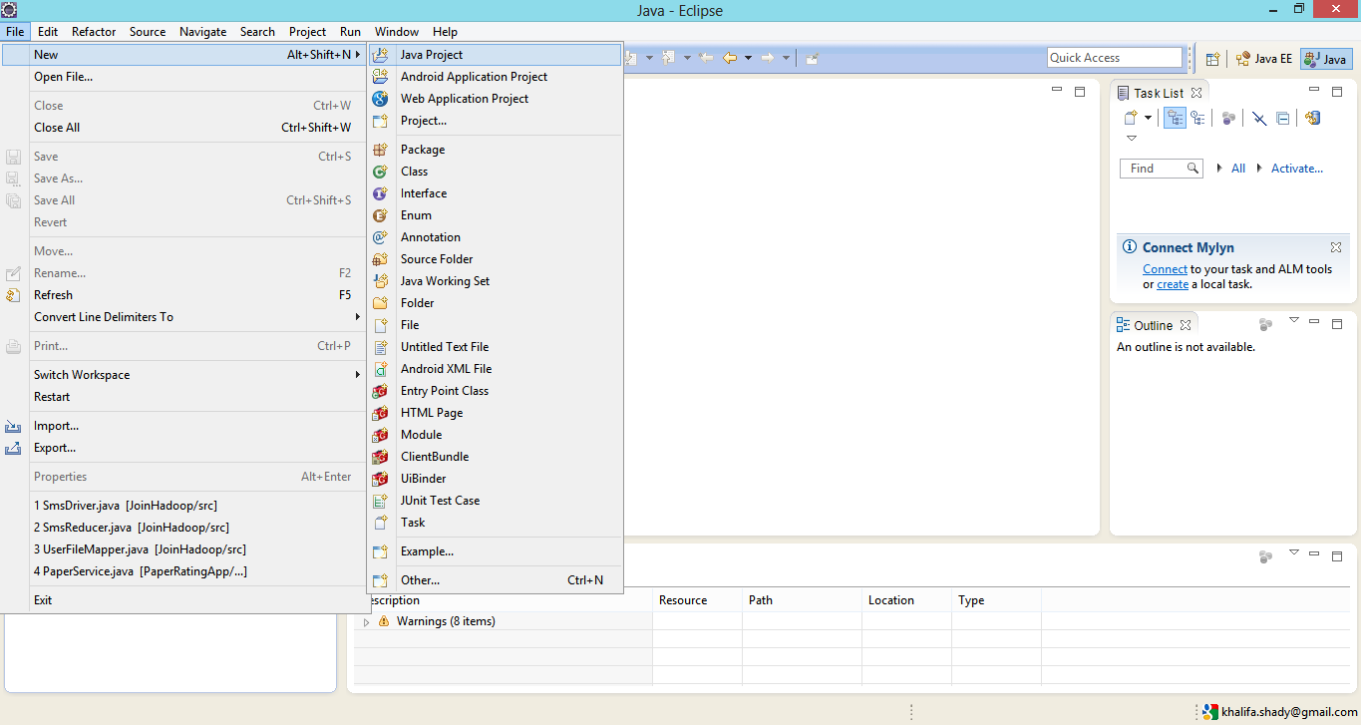
Create a new Java Project

Slide 16
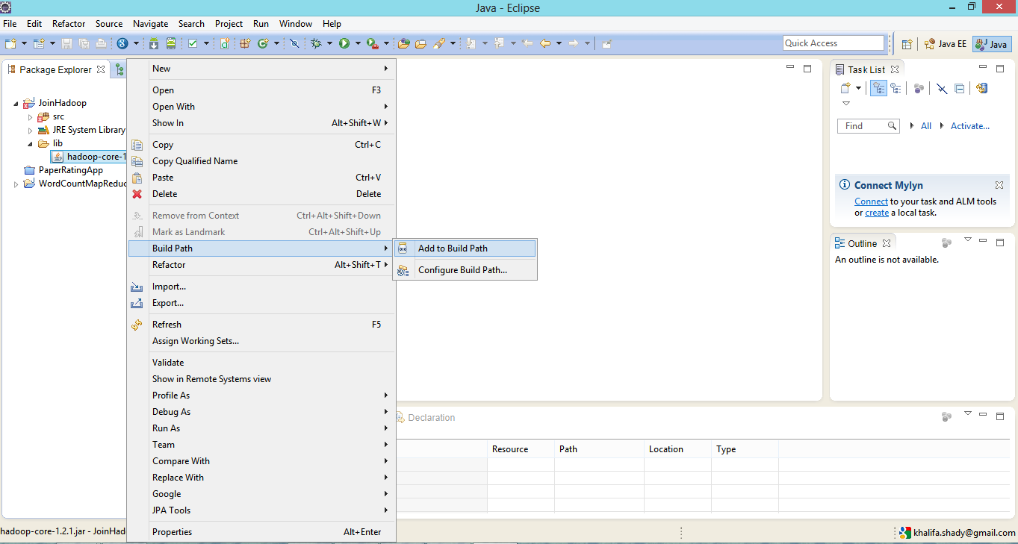
Add Hadoop jar to the project
Create a ‘lib’ folder in the project.
Copy and paste the Hadoop jar into the ‘lib’ folder.
Add the jar to the project build path.

Slide 17
Map classes: 1) UserFileMapper
public class UserFileMapper extends MapReduceBase implements Mapper<LongWritable, Text, Text, Text>
{
//variables to process Consumer Details
private String cellNumber,customerName,fileTag="CD~";
/* map method that process ConsumerDetails.txt and frames the initial key value pairs
Key(Text) – mobile number
Value(Text) – An identifier to indicate the source of input(using ‘CD’ for the customer details file) + Customer Name
*/
public void map(LongWritable key, Text value, OutputCollector<Text, Text> output, Reporter reporter) throws IOException
{
//taking one line/record at a time and parsing them into key value pairs
String line = value.toString();
String splitarray[] = line.split(",");
cellNumber = splitarray[0].trim();
customerName = splitarray[1].trim();
//sending the key value pair out of mapper
output.collect(new Text(cellNumber), new Text(fileTag+customerName));
}
}
UserDetails.txt
123 456, Jim
456 123, Tom
789 123, Harry
789 456, Richa
UserDetails.txt
<123 456, CD~Jim>
<456 123, CD~Tom>
<789 123, CD~Harry>
<789 456, CD~Richa>

Slide 18
Map classes: 2) DeliveryFileMapper
public class DeliveryFileMapper extends MapReduceBase implements Mapper<LongWritable, Text, Text, Text>
{
//variables to process delivery report
private String cellNumber,deliveryCode,fileTag="DR~";
/* map method that process DeliveryReport.txt and frames the initial key value pairs
Key(Text) – mobile number
Value(Text) – An identifier to indicate the source of input(using ‘DR’ for the delivery report file) + Status Code*/
public void map(LongWritable key, Text value, OutputCollector<Text, Text> output, Reporter reporter) throws IOException
{
//taking one line/record at a time and parsing them into key value pairs
String line = value.toString();
String splitarray[] = line.split(",");
cellNumber = splitarray[0].trim();
deliveryCode = splitarray[1].trim();
//sending the key value pair out of mapper
output.collect(new Text(cellNumber), new Text(fileTag+deliveryCode));
}
}
DeliveryDetails.txt
123 456, Delivered
456 123, Pending
789 123, Failed
789 456, Resend
DeliveryDetails.txt
<123 456, DR~Delivered>
<456 123, DR~Pending>
<789 123, DR~Failed>
<789 456, DR~Resend>

Slide 19
Reduce Class
public class SmsReducer extends MapReduceBase implements Reducer<Text, Text, Text, Text> {
//Variables to aid the join process
private String customerName,deliveryReport;
public void reduce(Text key, Iterator<Text> values, OutputCollector<Text, Text> output, Reporter reporter) throws IOException
{
while (values.hasNext())
{
String currValue = values.next().toString();
String valueSplitted[] = currValue.split("~");
/*identifying the record source that corresponds to a cell number
and parses the values accordingly*/
if(valueSplitted[0].equals("CD"))
{
customerName=valueSplitted[1].trim();
}
else if(valueSplitted[0].equals("DR"))
{
deliveryReport = valueSplitted[1].trim();
}
}
output.collect(new Text(customerName), new Text(deliveryReport));
}
}
Reduce Input
<123 456, CD~Jim>
<123 456, DR~Delivered>
<456 123, CD~Tom>
<456 123, DR~Pending>
Reduce Output
<Jim, Delivered>
<Tom, Pending>

Slide 20
Driver Class
public class SmsDriver extends Configured implements Tool
{
public int run(String[] args) throws Exception {
//get the configuration parameters and assigns a job name
JobConf conf = new JobConf(getConf(), SmsDriver.class);
conf.setJobName("SMS Reports");
//setting key value types for mapper and reducer outputs
conf.setOutputKeyClass(Text.class);
conf.setOutputValueClass(Text.class);
//specifying the custom reducer class
conf.setReducerClass(SmsReducer.class);
// If only one Mapper exists
// conf.setMapperClass(Mapper.class);
// FileInputFormat.addInputPath(conf, newPath(args[0]));
//Specifying the input directories(@ runtime) and Mappers independently for inputs from multiple sources
MultipleInputs.addInputPath(conf, new Path(args[0]), TextInputFormat.class, UserFileMapper.class);
MultipleInputs.addInputPath(conf, new Path(args[1]), TextInputFormat.class, DeliveryFileMapper.class);
//Specifying the output directory @ runtime
FileOutputFormat.setOutputPath(conf, new Path(args[2]));
JobClient.runJob(conf);
return 0;
}
public static void main(String[] args) throws Exception {
int res = ToolRunner.run(new Configuration(), new SmsDriver(), args);
System.exit(res);
}
}
Since we have 2 map functions and 2 input files, MulipleInputFormat is used to specify which input to go into which mapper.

Slide 21
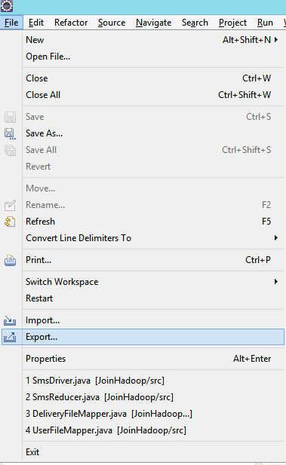
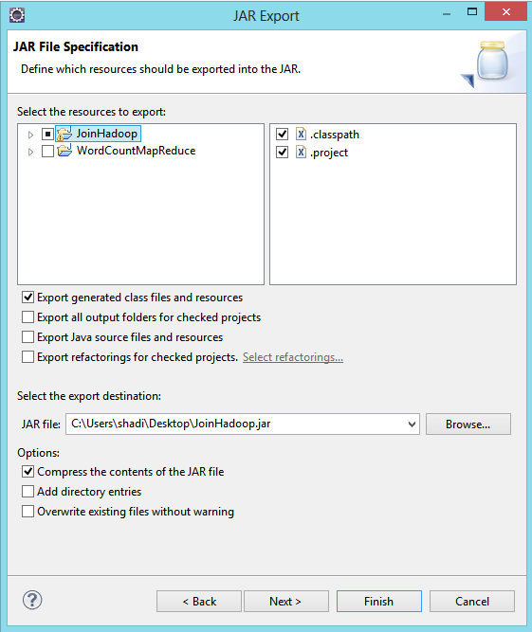
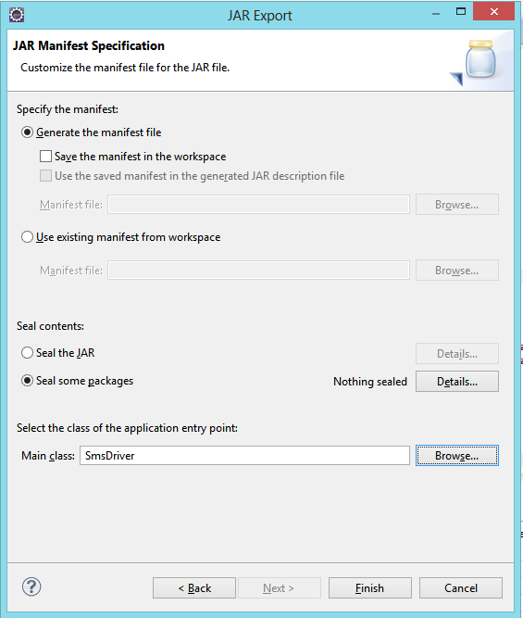
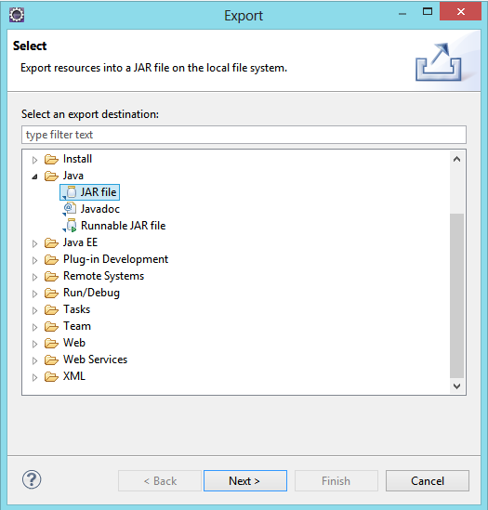
Export Project to Jar

Slide 22
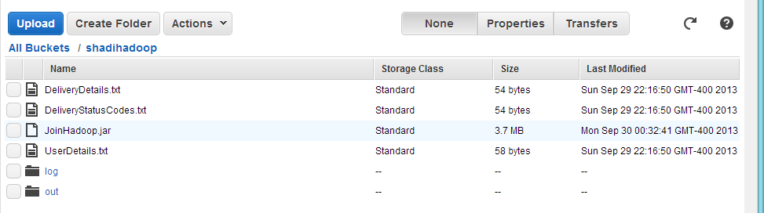
Uploading Project Jar and Data to S3
https://console.aws.amazon.com/s3/home?region=us-east-1

Slide 23
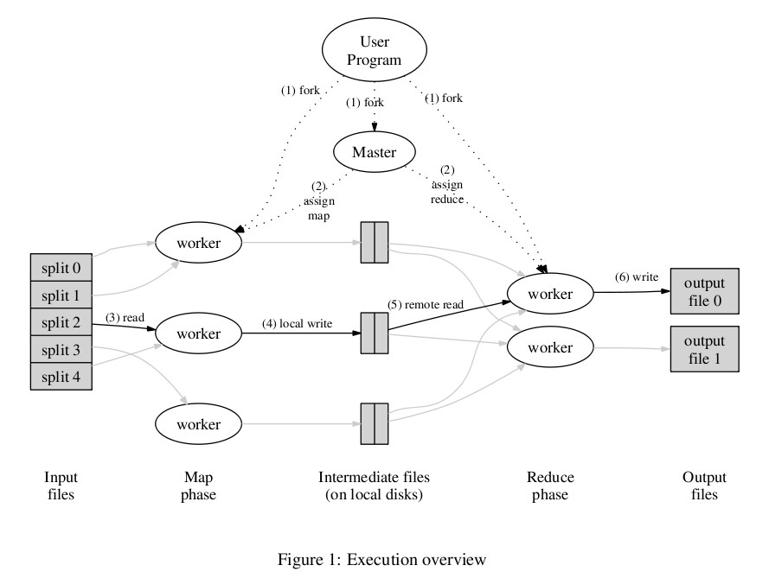
Hadoop Execution Overview

Slide 24
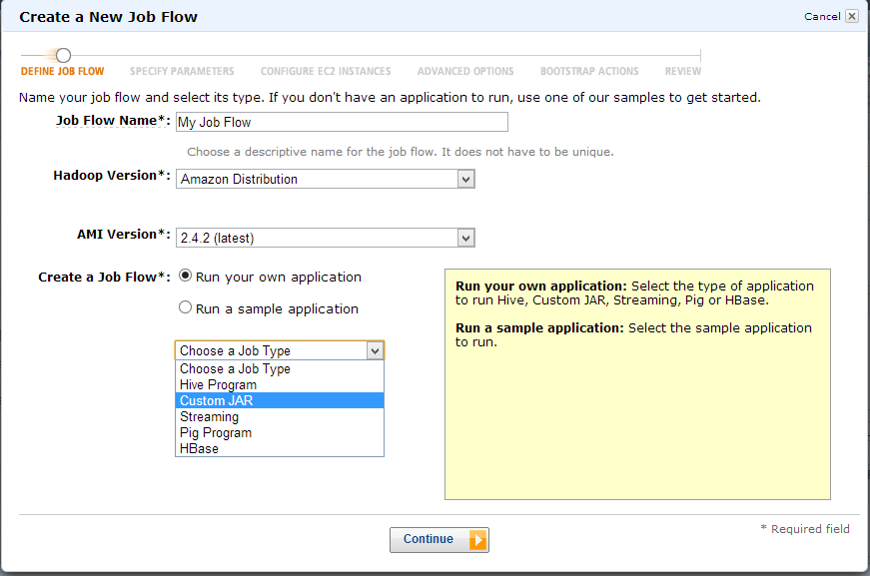


Using Amazon EMR
https://console.aws.amazon.com/elasticmapreduce/home?region=us-east-1

Slide 25
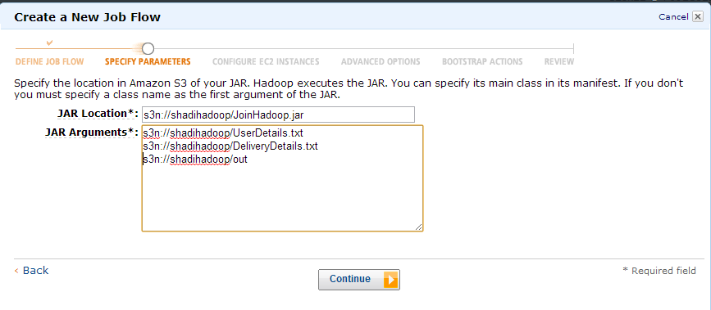
Using Amazon EMR
Make Sure that the output folder (3rd argument in our example) does NOT exists on S3 (MapReduce will create it)

Slide 26
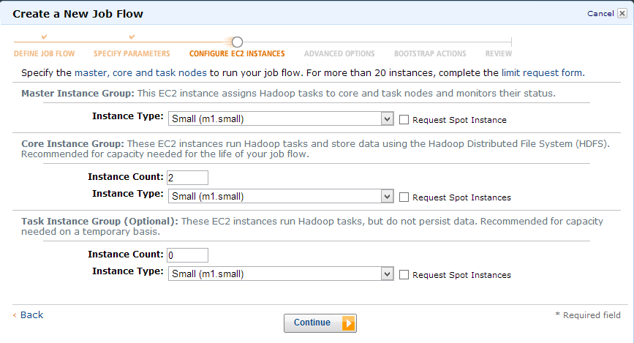
Using Amazon EMR
Set the number and type of the EC2 instances used to process your application

Slide 27
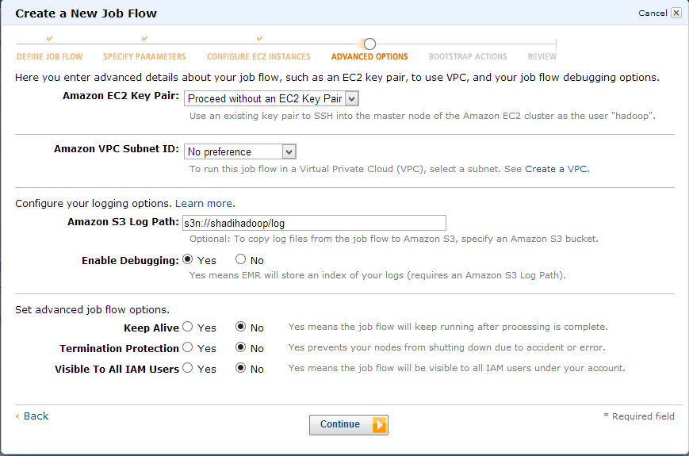
Using Amazon EMR
Remember to ENABLE the Debugging and provide the log Path

Slide 28
Performance
Using Amazon cloudWatch (Monitoring Tab) you can check the performance of the job

Slide 29
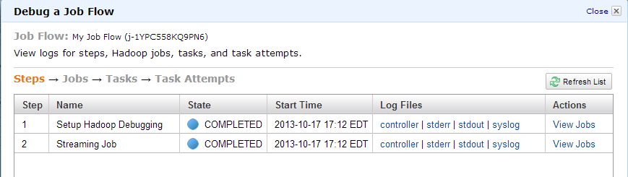
Debugging the Job
For detailed information on the MapReduce progress, click on the syslog link

Slide 30
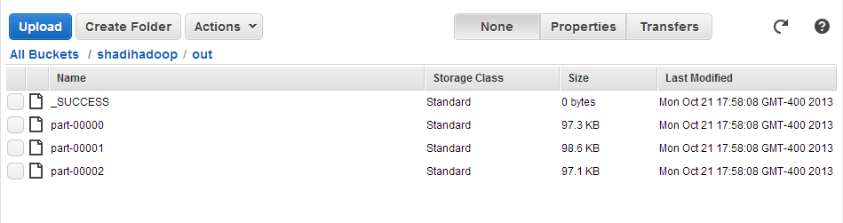
Accessing the Results on S3

Slide 31
Elastic Map Reduce
Questions?

