Slide 1
CISC P81 Computers: Applications & Implications
Week 9
The Internet
Shadi Khalifa
PhD Candidate
Database Systems Laboratory
Queen’s University
khalifa@cs.queensu.ca

Slide 2
How Internet Works!!
Quick review on Local Area Networks (LANs) and Network troubleshooting.
The journey of an IP packet: What happens when you type a URL in your web browser!!

Slide 3
We are going to Queen’s University
And
We found a really nice 5 bedroom house to live in
But
We have to setup the Network and Internet ourselves
Please help us!!
Hi, I’m Rachel
Hi, I’m Monica
Hi, I’m Ross

Slide 4
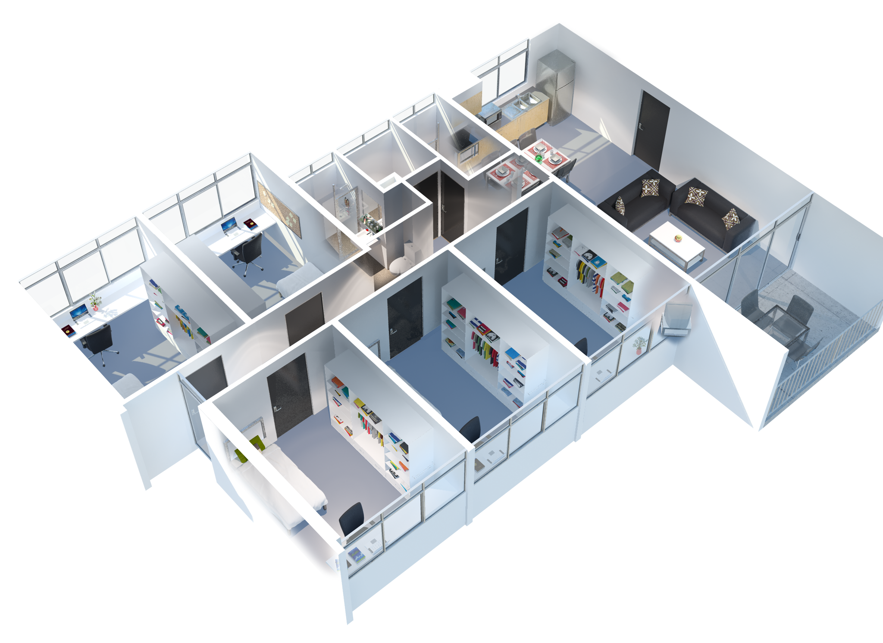
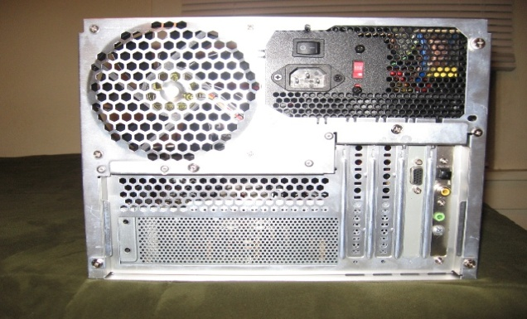
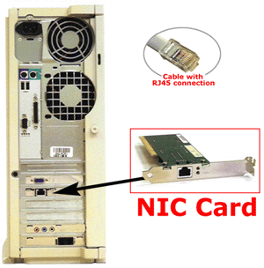
My computer is old and I want to connect to the Ethernet LAN , but there is no place to plug-in the Ethernet cable to my computer.
I need to buy a card to make it work, but what is it called?
Ross
Network Interface Controller (NIC)
Monica
Rachel
Notes:
Each computer on an Ethernet uses a network interface controller (NIC) to transmit information to and receive information from the network.

Slide 5
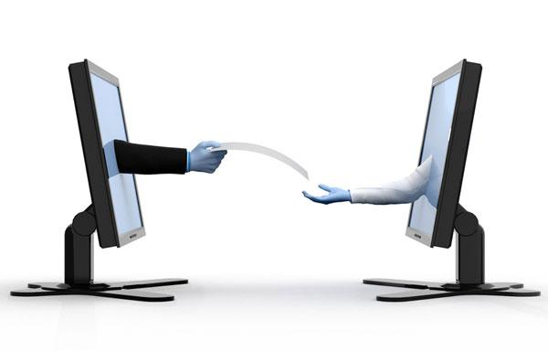
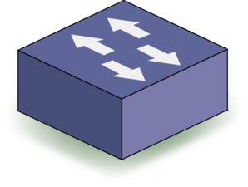
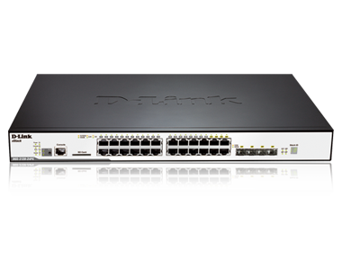
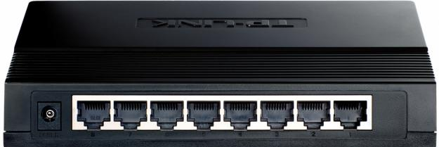
I want to share some files with Rachel and Monica, what device do I need to connect all three computers?
8-ports
24-ports
Ross
Monica
Switch
Rachel
Notes:
- Switches are network devices used to connect computing devices in a LAN.
- Switches are MAC Layer devices which means that they only understand MAC addresses but not IP addresses.
- Switches come in different sizes in term of number of ports, where a port is a slot to connect the Ethernet cable to.

Slide 6
Cat 6 twisted pair cable
Port1: Ross
Port2: Monica
Port3: Rachel
Ross
MAC: AC:BA:BB:E1:64:19
Monica
MAC: C4:54:23:EC:55:66
Rachel
Each NIC has a unique 48-bit MAC address
given as a six pairs of hexadecimal digits separated by colons
MAC: BA:AC:A1:12:B4:54
Notes:
Each NIC has a 48-bit MAC address that uniquely identifies a NIC on the network.
MAC address is often given as a six pairs of hexadecimal digits separated by colons or hyphens. The separation is only there for human readability.

Slide 7
Switch Forwarding Process
Ross is sending a frame to Rachel
Ross MAC
AC:BA:BB:E1:64:19
Source MAC
Address
Rachel MAC
BA:AC:A1:12:B4:54
Destination MAC
Address
Data
Port1: Ross
Port2: Monica
Port3: Rachel
Switch Forwarding Table
Ross
MAC: AC:BA:BB:E1:64:19
Monica
Port 1
Ross AC:BA:BB:E1:64:19
MAC: C4:54:23:EC:55:66
Port 2
Monica C4:54:23:EC:55:66
Port 3
Rachel BA:AC:A1:12:B4:54
Rachel
MAC: BA:AC:A1:12:B4:54
Notes:
Each Switch has a Forwarding Table that stores entries on how to reach each of the connected devices.
In MAC Frame:
============
- The source MAC address is the MAC address of the device sending the frame (in this example Ross MAC address AC:BA:BB:E1:64:19
The destination MAC address is the MAC address of the next-hop device. A next-hop device is the IP layer device that understands both MAC and IP addresses and is on the way to the destination. (in this example, only a switch exists on the way between Ross and Rachel, however, a switch is a MAC layer device not an IP layer device. So the next-hop MAC address for this Frame sent from Ross to Rachel is Rachel’s MAC address BA:AC:A1:12:B4:54
When a switch receives a frame:
1- Check the destination MAC address
2- Search in the switch forwarding table to find on which switch port the frame should exit to reach the destination.
3- Froward the frame to the exit port.
In this example: The frame’s destination MAC address is Rachel’s MAC address. When the switch searches its forwarding table, is will find in the 3rd entry that Rachel’s MAC address is mapped to port 3. Thus, the switch will forward the frame to port 3 to reach Rachel.

Slide 8
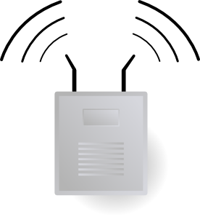
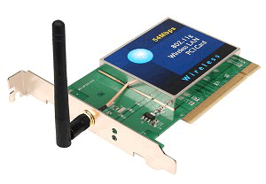
Grrr, Cables are running everywhere and I cannot connect to the LAN from the garden because the cable is not long enough.
I will buy a Wireless Access Point to provide wireless access.
Rachel will also need to buy a new Wireless NIC for her old computer.
Cat 6 twisted pair cable
Ross
MAC: AC:BA:BB:E1:64:19
Monica
W-MAC: 1C:BA:BB:E1:64:19
MAC: C4:54:23:EC:55:66
Switch Forwarding Table
W-MAC: 34:54:23:EC:55:66
Port 1
Ross, Rachel, and Monica VIA Wi-Fi
Rachel
MAC: BA:AC:A1:12:B4:54
W-MAC: 2A:AC:A1:12:B4:54
Notes:
Wireless Access Points have many benefits, the most obvious one is the elimination of cables.
For a computing device to use wireless technology, a wireless NIC must be installed to communicate wirelessly with the wireless access point.

Slide 9
Ross is sending a frame to Rachel using WiFi
Ross W-MAC
1C:BA:BB:E1:64:19
Source MAC
Address
Rachel W-MAC
2A:AC:A1:12:B4:54
Destination MAC
Address
Data
Switch Forwarding Table
Ross
MAC: AC:BA:BB:E1:64:19
Monica
MAC: C4:54:23:EC:55:66
Port 1
Ross : 1C:BA:BB:E1:64:19
Monica : 34:54:23:EC:55:66
Rachel : 2A:AC:A1:12:B4:54
W-MAC: 1C:BA:BB:E1:64:19
W-MAC: 34:54:23:EC:55:66
Rachel
MAC: BA:AC:A1:12:B4:54
W-MAC: 2A:AC:A1:12:B4:54
Notes:
When a wireless access point is connected to the switch and all other devices are disconnected, the switch forwarding table will only include a single entry.
Since the Wireless Access Point itself is not an IP layer device (Can’t be the source or destination of packets) then the switch will map the connected port (port 1) to the devices it can reach via the wireless access point (i.e Ross, Rachel and Monica).
When Ross’s device sends a frame, it uses its wireless NIC MAC address as the source MAC address (1C:BA:BB:E1:64:19) for the frame and Rachel’s wireless NIC MAC address (2A:AC:A1:12:B4:54) as the destination MAC address.
When the frame is received by the wireless access point, the packet is forwarded to the switch to decide where to send it after that.
The switch searches its forwarding table to find out on which port it should send the frame in order it to reach the destination (Rachel). The result of this search is to forward the frame to Port 1 back to the wireless access point.
The wireless access point will broadcast the frame. A broadcast is similar to what radio stations use where everyone receives the data. But this means that everyone will receive the frame sent only to Rachel!!! This is a huge security problem. Imagine if you are at Tim Hortons using your laptop to buy something online using your credit card. The credit card number is now in a frame transmitted to the wireless access point where all other connected devices at Tim Hortons can receive this Frame and read your credit card information!!
Luckily the wireless channels are encrypted as well as the online payment websites use the HTTPS protocol which also encrypts your credit card information. That is 2 layers of encryption, so no need to worry. Even though all devices receive the frame, they can’t decrypt it to read the data.
Moreover, the wireless NIC is configured so that when it receives a frame, it first check if the frame’s destination MAC address is its MAC address or not. If there is no match (in case of Ross and Monica), then the NIC will automatically drop/delete the frame. If there is a match (in case of Rachel), then the frame will be received and decrypted.

Slide 10
We have just moved into the house.
We can not live without INTERNET.
Please help us!!
Hi, I’m Chandler
Hi, I’m Joey

Slide 11
Internet History
In the 60’s, the U.S. Department of Defense’s Advanced Research Projects Agency (DARPA) was funding research in labs at various universities and research facilities across America. These widely-separated labs had computers that needed to share information.
Internet is a
Network of Networks

Slide 12
Terminologies
A computing device that provides a LAN with access to the Internet.
Gateway
Host/Client
A computing device that is connected to a network and issue requests.
Routers / Intermediate Nodes
A computing device that relays Internet packets to and from similar devices
Server
A computing device that serves the clients’ requests.
For the purposes of this course, consider “gateway” and “router” as synonyms. (It’s just easier that way.)

Slide 13
Circuit Switching
Disadvantages:
1- Wasted bandwidth (holding connection when no data to send)
2- Blocked connections (Nobody else can use this connection)
3- Connection set-up delay
4- What happens if an intermediate node is damaged or a cable is cut??
Advantages:
1- Guaranteed bandwidth (i.e Good for video streaming)
2– No worries about lost or out-of-order packets
3- Simple forwarding (No need to inspect a packet header)
4- Low per-packet overhead (No packet header)
Same as with a telephone call
Dial a number to establish a connection
Speak (i.e send data)
Hang up to release the connection
Intermediate Node
Establish connection request
Acknowledge Connection
Release connection request
Acknowledge Release
Source
Destination
Notes:
Same as with a telephone call
Dial a number to establish a connection
Speak (i.e send data)
Hang up to release the connection
Advantages:
1- Guaranteed bandwidth (i.e Good for video streaming)
2– No worries about lost or out-of-order packets
3- Simple forwarding (No need to inspect a packet header)
4- Low per-packet overhead (No packet header)
Disadvantages:
1- Wasted bandwidth (Source holds the connection even when no data to send)
2- Blocked connections (Nobody else can use this connection to transfer data)
3- Connection set-up delay
4- If, during such a communications session, one or more of the relaying switches went offline, or if some damaged occurred along the many kilometres of cable connecting two computers, then communication would cease between them until repairs had been carried out.

Slide 14
Packet Switching
Advantages:
1- packets from different sources can use the same link (Bandwidth used to full potential)
2- Not affected by line/node failure (use different path)
3- Availability – no waiting for call setup
Disadvantages:
1- Packets need to be reordered at the destination because they arrive out of sequence.
2- Under heavy use, packets suffer from different delays. Not so good for some types data streams (e.g. real-time video streams ).
3- Not reliable: Data packets can get lost or become corrupted.
Data is divided into a number of Packets.
Each packet has the addressing information required to reach the destination.
Packets can traverse different paths.
Intermediate Node
1
2
3
Source
4
5
Destination
Notes:
Data is divided into a number of Packets.
Each packet has the addressing information required to reach the destination.
Packets can traverse different paths.
Advantages
1- packets from different sources can use the same link (Bandwidth used to full potential)
2- Not affected by line/node failure (use different path)
3- Availability – no waiting for a direct connection to become available
Disadvantages:
1- Under heavy use different packets suffer from different delays (Not so good for some types data streams (e.g. real-time video streams )
2- Not reliable: Data packets can get lost or become corrupted
Protocols are needed for a reliable transfer
3- packets need to be ordered at the destination because they arrive out of sequence

Slide 15
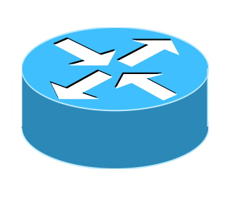
Internet
Let us install a Gateway/Router to connect to the internet.
MAC LAN:
11:11:11:33:33:33
MAC WAN:
11:11:11:22:22:22
Joey
MAC: DC:BD:BC:E5:64:69
Chandler
MAC: EE:54:B4:E9:24:AC
Ross
MAC: 1C:BA:BB:E1:64:19
Monica
MAC: 34:54:23:EC:55:66
Rachel
MAC: 2A:AC:A1:12:B4:54
Notes:
A router is an IP layer device (it understands both IP and MAC addresses).
A router has multiple ports (in most cases 2 ports), each port belongs to a different network. Thus, the main functionality of a router is connecting networks and routing packets between them by finding the best (or shortest) path between the source and destination.

Slide 16
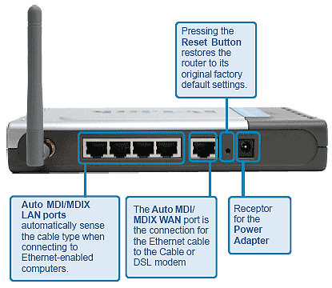
Internet
In large networks:
At home:
MAC LAN:
11:11:11:33:33:33
MAC WAN:
11:11:11:22:22:22
Access Point
Switch
Router
Joey
MAC: DC:BD:BC:E5:64:69
Chandler
Wireless DSL Router
MAC: EE:54:B4:E9:24:AC
Ross
MAC: 1C:BA:BB:E1:64:19
Monica
MAC: 34:54:23:EC:55:66
Rachel
MAC: 2A:AC:A1:12:B4:54
Notes:
In large networks (ex. Queen’s University network), specialized network devices are used. So there is a router device, a switch device and a wireless access point device. The reason behind this is that in large networks, number of users is large, thus the number of frames generated per second is huge. This requires high performance specialized network devices to handle this huge traffic.
However at home, there is less than 20 users and thus no much traffic generated. A Wireless DSL router is thus sufficient to handle this kind of low traffic. A Wireless DSL router combines the router, switch and wireless access point into a single device as illustrated in the picture.
A Wireless DSL router need to be connected to a DSL or Cable modem, the modem is then connected to the Internet Service Provider (ISP). Sometimes, Wireless DSL routers have an integrated DSL modem.

Slide 17
I need an Internet Protocol (IP) address to route my IP packets throughout the internet.
IPv4 address is 4 bytes (32 bits) long allowing 2³² = 4.3 ×10⁹ addresses. Consists of 4 one-byte values conventionally written as 4 decimal values separated by periods, For example:
130.15.1.16
is the IPv4 address of the Web server (sites.cs.queensu.ca) that hosts the course Web site. You can see this by browsing to:
http://130.15.1.16/courses/ciscp81
IPv6 address is 16 bytes (128 bits) long allowing 2¹²⁸ = 3.4×10³⁸ addresses. Consists of 8 groups of 4 hexadecimal digits separated by colons, for example :
2001:0db8:85a3:0042:1000:8a2e:0370:7334.
The two protocols (Ipv4 and IPv6) are not designed to be interoperable, complicating the transition to IPv6. IPv4 is still the most widely used till now.
Internet
MAC LAN:
11:11:11:33:33:33
MAC WAN:
11:11:11:22:22:22
Joey
MAC: DC:BD:BC:E5:64:69
Chandler
MAC: EE:54:B4:E9:24:AC
Ross
MAC: 1C:BA:BB:E1:64:19
Monica
MAC: 34:54:23:EC:55:66
Rachel
MAC: 2A:AC:A1:12:B4:54

Slide 18
So, How to get an IP address?
The Internet Corporation for Assigned Names and Numbers (ICANN) is the private sector, non-profit corporation created in 1998 to assume responsibility of authorizing various domain name registrars and Internet Service Providers (ISPs) to assign specific domain names and IP addresses or ranges of addresses respectively to individuals and organizations, commercial or otherwise.
Organizations then decide themselves how to distribute those addresses on departments which in turn allocate those addresses to specific hosts.
All IP addresses at Queen's are taken from the block of IP addresses that start with 130.15. *.* using a subnet mask 255.255.0.0
(i.e can use IP in range [130.15.0.0 till 130.15.255.255])
Thereafter, various subnets are allocated to specific departments. For example, School of Computing takes the first 3 subnets: 130.15.1.*, 130.15.2.*, 130.15.3.* using a subnet mask 255.255.255.0
Internet
ISP
MAC LAN: 11:11:11:33:33:33
IP Address LAN: ??
Subnet mask: ??
MAC WAN: 11:11:11:22:22:22
IP Address WAN: 130.15.1.100
Subnet mask: 255.255.255.0
Joey
MAC: DC:BD:BC:E5:64:69
IP Address: ??
Subnet mask: ??
Chandler
MAC: EE:54:B4:E9:24:AC
IP Address: ??
Subnet mask: ??
Ross
MAC: 1C:BA:BB:E1:64:19
IP Address: ??
Subnet mask: ??
Monica
MAC: 34:54:23:EC:55:66
IP Address: ??
Subnet mask: ??
Rachel
MAC: 2A:AC:A1:12:B4:54
IP Address: ??
Subnet mask: ??

Slide 19
Internet
So, How to automatically set the IP addresses for LAN computers?
Dynamic Host Configuration Protocol (DHCP) is a network protocol (in form of a client-server application) that is used to lease IP address to hosts connected to a LAN.
Typically, the DHCP server application runs on the Router but it can run on any other computer in the LAN. DHCP client application comes with the OS and runs on the hosts.
DHCP also distribute some very important information for hosts to connect to internet:
1- IP Address 2- Subnet Mask 3- Default Gateway IP Address 4- Domain Name System (DNS) IP Address .
The DHCP server maintains a database of available IP addresses and configuration information. DHCP servers typically grant IP addresses to hosts only for a limited interval (24 hours). Hosts are responsible for renewing their IP address before interval expires.
Only ONE DCHP server should exist in a LAN.
DHCP server can be very easily HACKED!!!
DHCP Starvation and Man-in-the-middle Attacks!!!
ISP
MAC LAN: 11:11:11:33:33:33
IP Address LAN: ??
Subnet mask: ??
MAC WAN: 11:11:11:22:22:22
IP Address WAN: 130.15.1.100
Subnet mask: 255.255.255.0
Joey
MAC: DC:BD:BC:E5:64:69
IP Address: ??
Subnet mask: ??
Chandler
MAC: EE:54:B4:E9:24:AC
IP Address: ??
Subnet mask: ??
Ross
MAC: 1C:BA:BB:E1:64:19
IP Address: ??
Subnet mask: ??
Monica
MAC: 34:54:23:EC:55:66
IP Address: ??
Subnet mask: ??
Rachel
MAC: 2A:AC:A1:12:B4:54
IP Address: ??
Subnet mask: ??

Slide 20
ISP
IPv4 only supports 4.3 billion addresses and that is not enough
to provide a unique Public IP address to all devices on the internet!!!
Solution: Private IP address ranges
10.*.*.* (subnet mask:255.0.0.0) [10.0.0.0 - 10.255.255.255] = 16,777,216 IPs
172.16.*.* (subnet mask: 255.240.0.0) [172.16.0.0 - 172.31.255.255] = 1,048,576 IPs
192.168.*.* (subnet mask: 255.255.0.0) [192.168.0.0 - 192.168.255.255] = 65,536 IPs
Private IPs are repeated in different LANs but are unique within the same LAN.
Private IPs NEVER go to the internet. Private IPs are encapsulated with the Router’s Unique Public WAN IP using Network Address Translation (NAT).
If a host cannot obtain an IP address via DHCP, an address from 169.254.1.* (subnet mask: 255.255.255.0) [169.254.1.0 - 169.254.254.255] may be assigned. Getting an IP in this range will NOT allow you to use the internet.
Each host has a local IP even if it is not connected to a router. Local IP is the same on all hosts (127.0.0.1) and is called localhost mainly used for testing the networking protocol.
Internet
ISP
MAC WAN: 11:11:11:55:55:55
IP Address WAN: 13.15.1.101
Subnet mask: 255.255.255.0
MAC LAN: 11:11:11:33:33:33
IP Address LAN: 10.0.0.1
Subnet mask: 255.0.0.0
MAC LAN: 11:11:11:33:33:33
IP Address LAN: ??
Subnet mask: ??
MAC WAN: 11:11:11:22:22:22
IP Address WAN: 130.15.1.100
Subnet mask: 255.255.255.0
MAC LAN: 11:11:11:44:44:44
IP Address LAN: 10.0.0.1
Subnet mask: 255.0.0.0
Joey
Phoebe
MAC: DC:BD:BC:E5:64:69
IP Address: 10.0.0.2
Subnet mask: 255.0.0.0
Gateway: 10.0.0.1
MAC: DC:BD:BC:E5:64:69
IP Address: ??
Subnet mask: ??
Chandler
MAC: 11:BA:AC:E5:A4:A9
IP Address: 10.0.0.2
Subnet mask: 255.0.0.0
Gateway: 10.0.0.1
MAC: EE:54:B4:E9:24:AC
IP Address: 10.0.0.6
Subnet mask: 255.0.0.0
Gateway: 10.0.0.1
MAC: EE:54:B4:E9:24:AC
IP Address: ??
Subnet mask: ??
Ross
MAC: 1C:BA:BB:E1:64:19
IP Address: ??
Subnet mask: ??
MAC: 1C:BA:BB:E1:64:19
IP Address: 10.0.0.3
Subnet mask: 255.0.0.0
Gateway: 10.0.0.1
Monica
MAC: 34:54:23:EC:55:66
IP Address: ??
Subnet mask: ??
MAC: 34:54:23:EC:55:66
IP Address: 10.0.0.5
Subnet mask: 255.0.0.0
Gateway: 10.0.0.1
Rachel
MAC: 2A:AC:A1:12:B4:54
IP Address: 10.0.0.4
Subnet mask: 255.0.0.0
Gateway: 10.0.0.1
MAC: 2A:AC:A1:12:B4:54
IP Address: ??
Subnet mask: ??

Slide 21
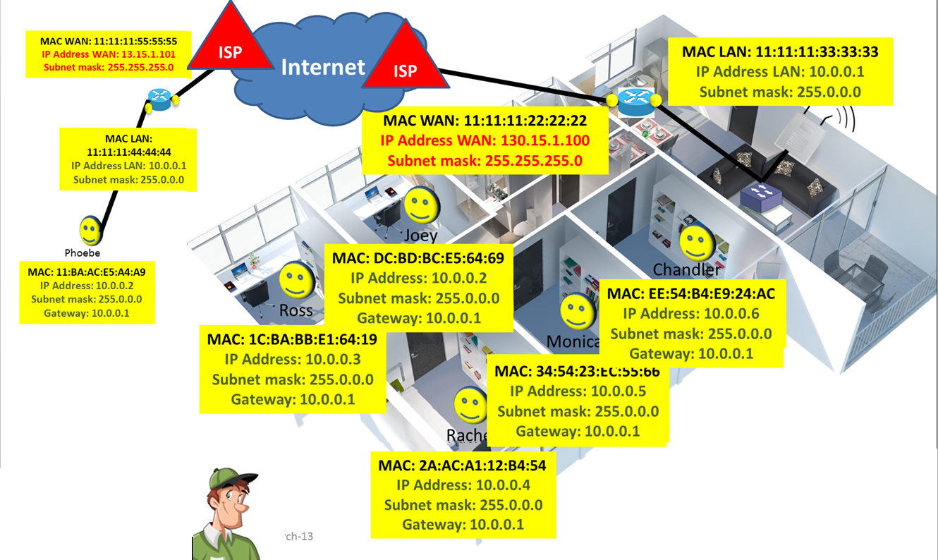
Does this means that I will need to memorize the IP addresses of all websites I want to visit!!!
Fortunately, hosts can be given human-friendly domain names, such as queensu.ca.
These domain names are mapped to specific IP addresses using the
Domain Name System (DNS)
NOTE: Having a “.ca“ domain name does NOT mean that the files are hosted in Canada.
Leasing a domain name allows creating sub-domains, such as cs.queensu.ca
Each computer maintains a local DNS cache to visited website for a faster IP translation.
If the requested domain name was NOT found in the local DNS Cache, then the local network's DNS server is asked.
If the requested domain name was not found in the local network’s DNS server, then one of the 13 Root name servers is asked.

Slide 22
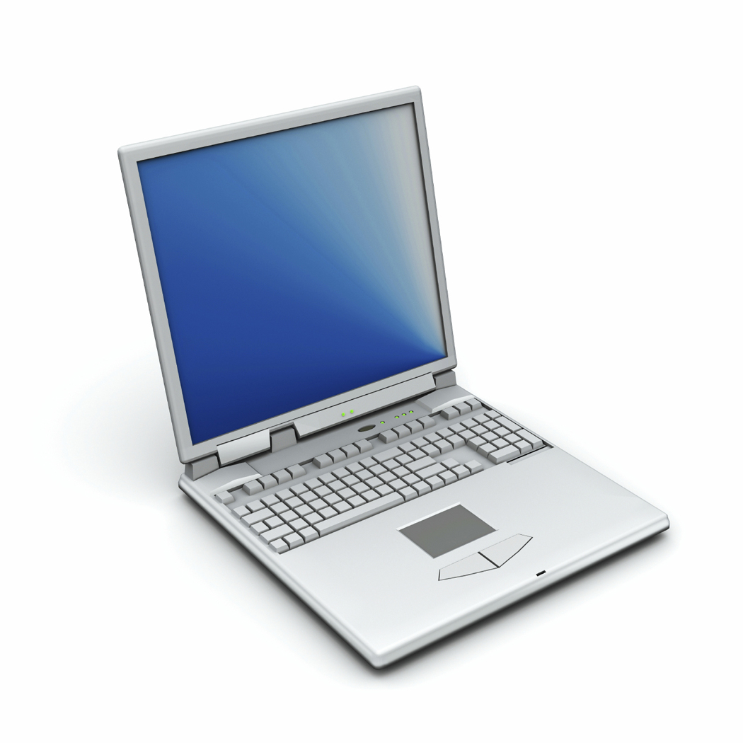
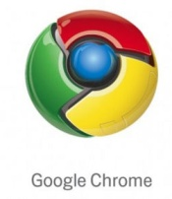
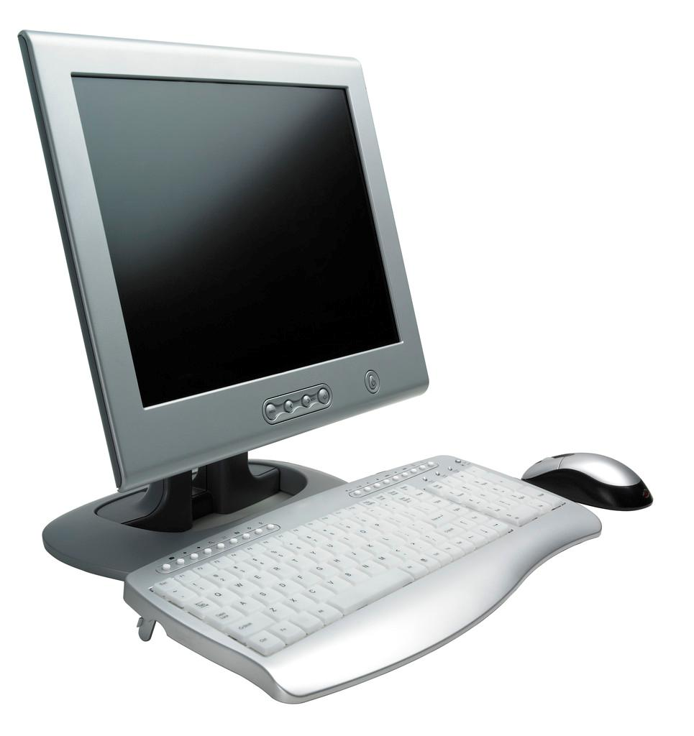
Given 2 computers communicating over the internet
On each one of them multiple network applications are running
Given that, each computer has only a single IP address.
How come when Phoebe uses Skype, the messages are not received by Chandler’s Yahoo! messenger!!
To allow multiple network applications to run on the same computer, Each network application LISTENs to an assigned Transmission Control Protocol (TCP) port number.
12345
23456
12345
34567
Phoebe
34567
45123
Chandler
TCP Port number (2-byte positive integer value [0 – 65535]):
- Uniquely identifies a network application (not repeated on same computer).
Locally significant (same port number can be assigned to different network applications on different computer).
Famous TCP port numbers (0 to 1023 reserved for the well-known applications):
File Transfer Protocol (FTP) for uploading/downloading files listens to port 22
Hypertext Transfer Protocol (HTTP) for web browsing listens to port 80
Domain Name System (DNS) listens to port 53
Notes:
Given 2 computers communicating over the internet
On each one of them multiple network applications are running
Given that, each computer has only a single IP address.
How come when Phoebe uses Skype, the messages are not received by Chandler’s Yahoo! messenger!!
To allow multiple network applications to run on the same computer, Each network application LISTENs to an assigned Transmission Control Protocol (TCP) port number
TCP Port number (2-byte positive integer value [0 – 65535]):
- Uniquely identifies a network application (not repeated on same computer).
Locally significant (same port number can be assigned to different network applications on different computer).
Famous TCP port numbers (0 to 1023 reserved for the well-known applications):
File Transfer Protocol (FTP) for uploading/downloading files listens to port 22
Hypertext Transfer Protocol (HTTP) for web browsing listens to port 80
Domain Name System (DNS) listens to port 53

Slide 23
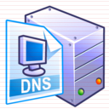
Putting it all together
MAC: 11:BA:AC:E5:A4:A9
IP Address: 10.0.0.2
Subnet mask: 255.0.0.0
Gateway: 10.0.0.1
MAC WAN: 11:11:11:55:55:55
IP Address WAN: 13.15.1.101
Subnet mask: 255.255.255.0
MAC WAN: 22:11:11:55:55:55
IP Address WAN: 130.150.10.102
Subnet mask: 255.255.255.0
R1
ISP 2
Gateway
ISP 1
Cost = 50
Port: 23456
ISP 3
Gateway
Cost = 100
R2
MAC WAN: 22:11:11:55:55:66
IP Address WAN: 20.150.10.102
Subnet mask: 255.255.255.0
MAC LAN: 11:11:11:44:44:44
IP Address LAN: 10.0.0.1
Subnet mask: 255.0.0.0
DNS server
IP Address: 100.100.100.100
Port: 53
Port: 80
MAC LAN: 22:11:11:44:44:44
IP Address LAN: 130.150.20.1
Subnet mask: 255.255.255.0
Domain | IP
Google.com | 130.150.20.2
… | …
MAC: AA:BA:AC:E5:A4:A9
IP Address: 130.150.20.2
Subnet mask: 255.255.255.0
Gateway: 130.150.20.1
Source MAC
Next Hop MAC
MAC Header
11:BA:AC:E5:A4:A9
11:11:11:44:44:44
Source IP
Destination IP
TTL
Protocol
IP Header
10.0.0.2
130.150.20.2
57
6: TCP
Searching Local DNS Cache for google.com
google.com
Not Found
Query DNS Server for google.com
Send URL to google.com
Source Port
Destination Port
Ack
Sequence
Number
TCP Header
23456
80
0
1
Send me the HTML code of google.com
MAC Frame Data Field
IP Packet Data Field
Application Data
TCP Segment Data Field
Protocol
Domain
Port
Notes:
To send data over the internet:
1- Data is first segmented at the Transport Layer by the TCP to smaller chunks to fit into the packets.
2- TCP header contains the following fields:
i- Source TCP port number: This defines the TCP port number of the application sending the request.
ii- Destination TCP port number: This defines the TCP port number of the application to receive the request.
iii- Ack field: used in a reply message to let an originating host know that a TCP packet, or perhaps a group of TCP packets, arrived intact, or that a specific packet was lost and needs to be sent again.
iv-Sequence Number field: TCP software on an originating host may take a lengthy message and split it up over a number of TCP segments, but the sequence number it attaches to each segment will let the destination host know what order it needs to use to reassemble the segment’s data into the original message.
3- IP header is then used to route the packet between routers till it reaches the destination. The IP header contains the following fields:
i- Source IP Address: This defines the IP address of the device sending the request.
ii- Destination IP Address: This defines the IP address of the device to receive the request.
iii- TTL field: is the Time to Live: A single byte-sized value. The originating host puts a positive integer value in this space, which is has 1 subtracted from it at each encounter with a gateway. If the TTL value reaches 0, it's generally because the packet has entered an infinite loop of gateways. At that point, the packet is deleted and an error message sent to the originating host.
iv-Protocol Field: Defines which protocol runs in the Transport Layer. TCP is used most of the time and its code is 6
4- MAC header is used to send the packet to the next IP layer device. The MAC header contains the following fields:
i- Source MAC Address: This defines the MAC address of the device’s NIC sending the frame (This might the source or an intermediate node).
ii- Destination MAC Address: This defines the MAC address of the next IP layer device to receive the frame (This might an intermediate node or the destination).

Slide 24
Putting it all together
MAC: 11:BA:AC:E5:A4:A9
IP Address: 10.0.0.2
Subnet mask: 255.0.0.0
Gateway: 10.0.0.1
MAC WAN: 11:11:11:55:55:55
IP Address WAN: 13.15.1.101
Subnet mask: 255.255.255.0
MAC WAN: 22:11:11:55:55:55
IP Address WAN: 130.150.10.102
Subnet mask: 255.255.255.0
R1
ISP 2
Gateway
ISP 1
Cost = 50
Port: 23456
ISP 3
Gateway
Cost = 100
R2
MAC WAN: 22:11:11:55:55:66
IP Address WAN: 20.150.10.102
Subnet mask: 255.255.255.0
MAC LAN: 11:11:11:44:44:44
IP Address LAN: 10.0.0.1
Subnet mask: 255.0.0.0
DNS server
IP Address: 100.100.100.100
Port: 53
Port: 80
MAC LAN: 22:11:11:44:44:44
IP Address LAN: 130.150.20.1
Subnet mask: 255.255.255.0
Domain | IP
Google.com | 130.150.20.2
… | …
MAC: AA:BA:AC:E5:A4:A9
IP Address: 130.150.20.2
Subnet mask: 255.255.255.0
Gateway: 130.150.20.1
Source MAC
Next Hop MAC
11:11:11:44:44:44
MAC Header
11:11:11:55:55:55
ISP1 MAC Address
11:BA:AC:E5:A4:A9
Source IP
Destination IP
TTL
Protocol
130.150.20.2
56
13.15.1.101
57
6: TCP
IP Header
10.0.0.2
Searching Local DNS Cache for google.com
google.com
Not Found
Query DNS Server for google.com
Send URL to google.com
Source Port
Destination Port
Ack
Sequence
Number
TCP Header
23456
80
0
1
Send me the HTML code of google.com
MAC Frame Data Field
IP Packet Data Field
Application Data
TCP Segment Data Field
Protocol
Domain
Port
Notes:
For a request to be sent to google.com
==========================
1- The user types http://google.com:80 to the web browser. “http” is the protocol used, “google.com” is the domain name of the server, “:80” is the destination application TCP port number. The default port number for http is “80”, so you don’t need to write it.
2- The source device first checks its local DNS cache to find the IP address mapped to “google.com”
3- Assuming that the source device fails to find “google.com” IP address in its local DNS cache, then a DNS request is sent to the network’s DNS server.
4- the DNS server will check its DNS table and reply with the IP address mapped to “google.com”
5- The source then forms a packet with the following information:
TCP header:
- Source port: web browser port (23456)
- Destination port: html server on google.com (80)
- Ack: 0 since this is a data packet not a reply to a packet
- Sequence Number: 1 since the amount of data to send is small so there is no need to segment the data, thus there is only one segment.
IP header:
- Source IP: sending computer IP address 10.0.0.2
- Destination IP: Google.com IP (130.150.20.2)
- TTL: default value is 57
- Protocol: 6 = TCP
MAC header:
-Source MAC address: sending computer MAC address : 11:BA:AC:E5:A4:A9
- Destination MAC address: gateway MAC address since the gateway is the next IP device on the route to the destination.
6- When the packet reaches the gateway (because the destination MAC address of the packet was set to the gateway’s MAC address), the gateway will:
i- Decrement the TTL value (57-1 = 56)
ii- Check the source IP address to see if it is a public or private IP. If it is a Public IP, then nothing is modified. However, if the IP is private as in our case, the gateway will replace the source IP with its own IP address using Network Address Translation (NAT) since Private IPs are not allowed on the internet.
iii- Modify the source MAC address to its own MAC address and modify the destination MAC address to the ISP’s router MAC address.

Slide 25
Putting it all together
MAC: 11:BA:AC:E5:A4:A9
IP Address: 10.0.0.2
Subnet mask: 255.0.0.0
Gateway: 10.0.0.1
MAC WAN: 11:11:11:55:55:55
IP Address WAN: 13.15.1.101
Subnet mask: 255.255.255.0
MAC WAN: 22:11:11:55:55:55
IP Address WAN: 130.150.10.102
Subnet mask: 255.255.255.0
R1
ISP 2
Gateway
ISP 1
Cost = 50
Port: 23456
ISP 3
Gateway
Cost = 100
R2
MAC WAN: 22:11:11:55:55:66
IP Address WAN: 20.150.10.102
Subnet mask: 255.255.255.0
MAC LAN: 11:11:11:44:44:44
IP Address LAN: 10.0.0.1
Subnet mask: 255.0.0.0
DNS server
IP Address: 100.100.100.100
Port: 53
Port: 80
MAC LAN: 22:11:11:44:44:44
IP Address LAN: 130.150.20.1
Subnet mask: 255.255.255.0
Domain | IP
Google.com | 130.150.20.2
… | …
MAC: AA:BA:AC:E5:A4:A9
IP Address: 130.150.20.2
Subnet mask: 255.255.255.0
Gateway: 130.150.20.1
Source MAC
Next Hop MAC
ISP1 MAC Address
R1 MAC Address
11:11:11:44:44:44
MAC Header
11:11:11:55:55:55
ISP1 MAC Address
11:BA:AC:E5:A4:A9
Source IP
Destination IP
TTL
Protocol
130.150.20.2
56
55
13.15.1.101
57
6: TCP
IP Header
10.0.0.2
Searching Local DNS Cache for google.com
google.com
Not Found
Query DNS Server for google.com
Send URL to google.com
Source Port
Destination Port
Ack
Sequence
Number
TCP Header
23456
80
0
1
Send me the HTML code of google.com
MAC Frame Data Field
IP Packet Data Field
Application Data
TCP Segment Data Field
Protocol
Domain
Port
Notes:
7- When the packet reaches the ISP’s router (because the destination MAC address of the packet was set to the router’s MAC address), the router will:
i- Decrement the TTL value (56-1 = 55)
ii- Check the Routing Table to see which path to the destination is the best to send the packet on.
Routing:
Each router maintains a routing table
A routing table contains information on the possible paths to reach different destinations and the cost associated with each path.
iii- After the best path is determined, the router checks if there is a need to Fragment the packet to smaller chunks so that they can be transmitted on the new network.
IP fragmentation:
- Routers connects different networks to create the internet.
- Not all networks have the same packet size
- As the packet goes form one router to another, each router decides whether to fragment the packet to smaller chunks or not based on the network used to send the packet.
Packets are then reassembled at the destination.
iv- The router then modifies the source MAC address to its own MAC address and modify the destination MAC address to the MAC address of the next router on the way.
8- Step 7 is repeated until the packet reaches the destination.

Slide 26
Putting it all together
MAC: 11:BA:AC:E5:A4:A9
IP Address: 10.0.0.2
Subnet mask: 255.0.0.0
Gateway: 10.0.0.1
MAC WAN: 11:11:11:55:55:55
IP Address WAN: 13.15.1.101
Subnet mask: 255.255.255.0
MAC WAN: 22:11:11:55:55:55
IP Address WAN: 130.150.10.102
Subnet mask: 255.255.255.0
R1
ISP 2
Gateway
ISP 1
Cost = 50
Port: 23456
ISP 3
Gateway
Cost = 100
R2
MAC WAN: 22:11:11:55:55:66
IP Address WAN: 20.150.10.102
Subnet mask: 255.255.255.0
MAC LAN: 11:11:11:44:44:44
IP Address LAN: 10.0.0.1
Subnet mask: 255.0.0.0
DNS server
IP Address: 100.100.100.100
Port: 53
Port: 80
MAC LAN: 22:11:11:44:44:44
IP Address LAN: 130.150.20.1
Subnet mask: 255.255.255.0
Domain | IP
Google.com | 130.150.20.2
… | …
MAC: AA:BA:AC:E5:A4:A9
IP Address: 130.150.20.2
Subnet mask: 255.255.255.0
Gateway: 130.150.20.1
Source MAC
Next Hop MAC
R1 MAC Address
ISP1 MAC Address
22:11:11:44:44:44
AA:BA:AC:E5:A4:A9
11:11:11:44:44:44
MAC Header
11:11:11:55:55:55
ISP1 MAC Address
11:BA:AC:E5:A4:A9
Source IP
Destination IP
TTL
Protocol
13.15.1.101
57
130.150.20.2
56
55
13.15.1.101
57
6: TCP
130.150.20.2
IP Header
10.0.0.2
Searching Local DNS Cache for google.com
google.com
Not Found
Query DNS Server for google.com
Send URL to google.com
Source Port
Destination Port
Ack
Sequence
Number
80
23456
23456
TCP Header
80
0
1
Send me the HTML code of google.com
MAC Frame Data Field
IP Packet Data Field
Application Data
HTML code of google.com
TCP Segment Data Field
Protocol
Domain
Port
Notes:
9- The destination then puts the requested page (in our case, the home page of “google.com”) into a packet with the following header values:
TCP header:
- Source port: html server on google.com (80)
- Destination port: web browser port (23456)
- Ack: 0 since this is a data packet not a reply to a packet
- Sequence Number: 1 since the amount of data to send is small so there is no need to segment the data, thus there is only one segment.
IP header:
- Source IP: Google.com IP 130.150.20.2
- Destination IP: the gateway of the sending computer Public IP address (13.15.1.101). when the packet is received at the gateway, the NAT process will be reversed and the packet will be delivered to the computer.
- TTL: default value is 57
- Protocol: 6 = TCP
MAC header:
-Source MAC address: “google.com” server MAC address : AA:BA:AC:E5:A4:A93
- Destination MAC address: “google.com” server’s gateway MAC address since the gateway is the next IP device on the route to the destination.
10- The packet will then traverse the same or different route based on the intermediate routers decisions until it reaches the computer that sent the request.
11- The computer then sends the packet to the web browser, which displays the “google.com” home page.

Slide 27
